Slide 1


Slide 2
Jobi is a site specialized in jobs, it is directed to
All employers who need employees
Jobs seekers
And businesses owners who want to market theirs businesses.

Slide 3
Our goal is to help people find their Dream Jobs

Slide 4

Idea

Slide 5

Analysis

Slide 6

Requirement

Slide 7
Functional Requirement:
Registration
Home page contain slider
Pages to show Jobs, Jobs Seeks & Companies and each details
Forms pages to add jobs , etc …
User dashboard & Admin dashboard
Filter

Slide 8
Non-Functional Requirement
Validation and Verification
Security
User can show only else if content owner
Usability

Slide 9
Languages & Technologies
MERN-Stack
( React, Node.JS, MongoDB )

Slide 10
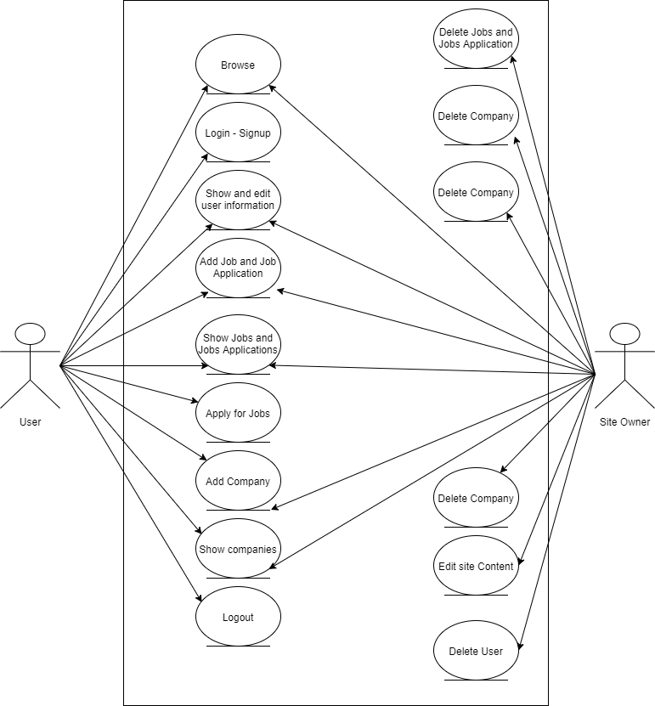

Slide 11
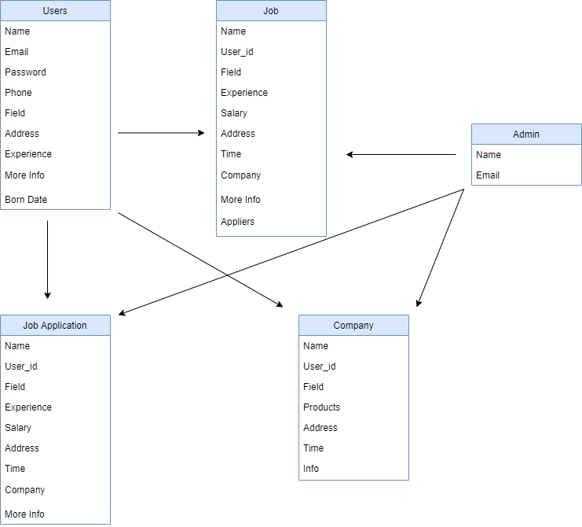

Slide 12
Mockup

Slide 13
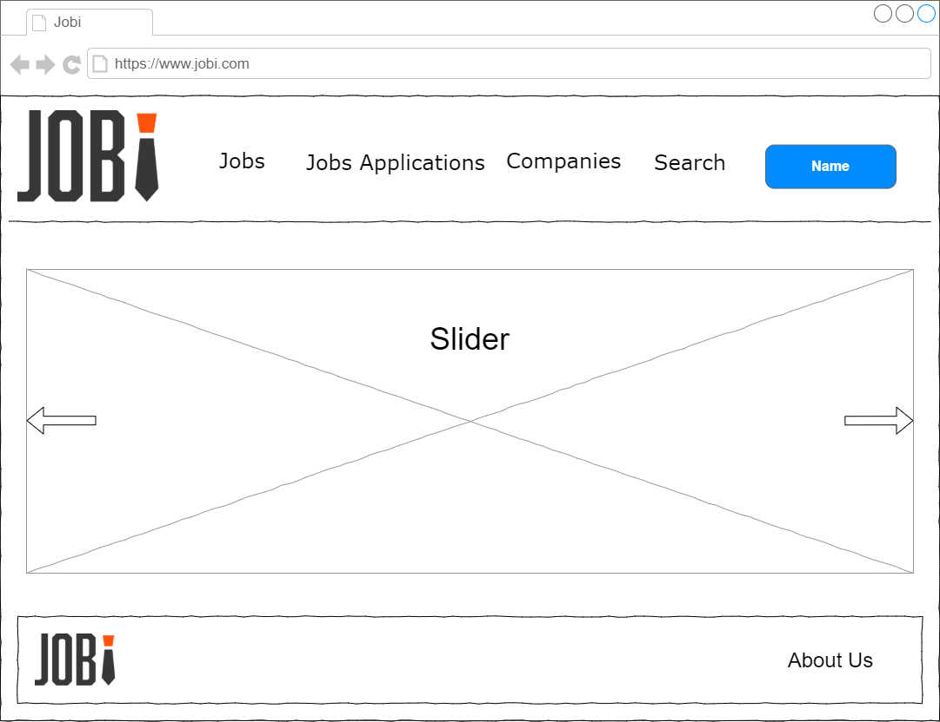

Slide 14
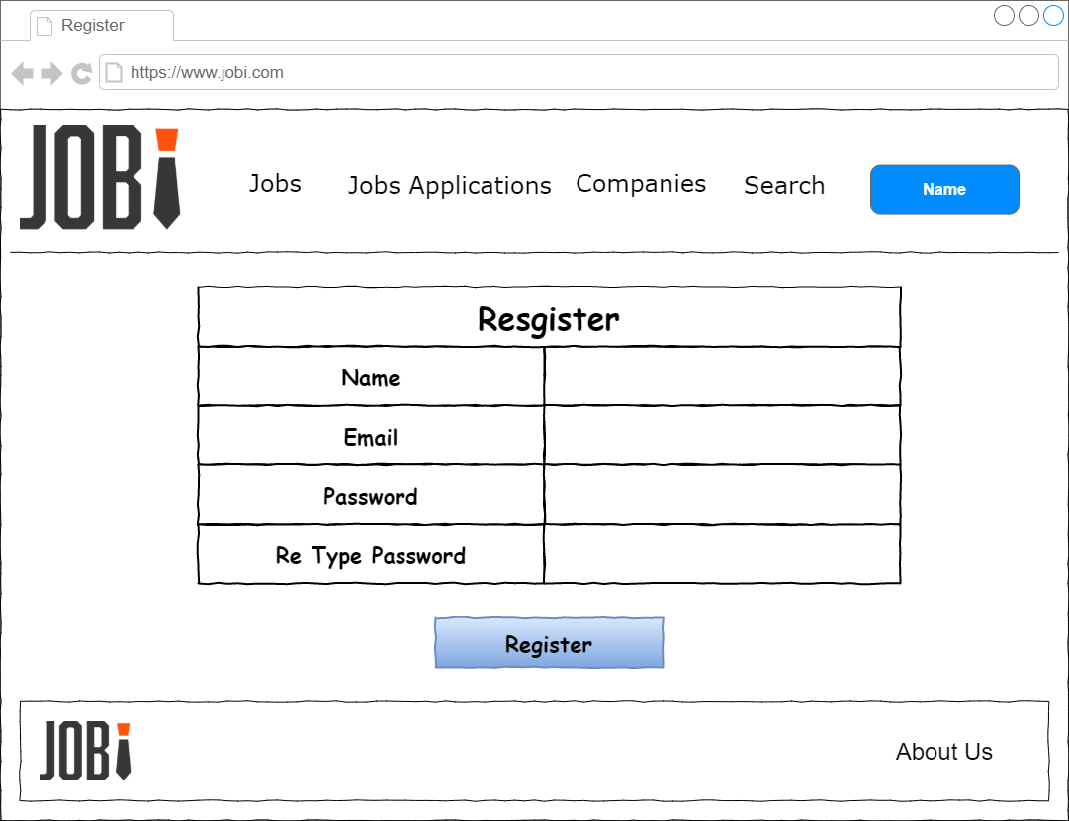

Slide 15
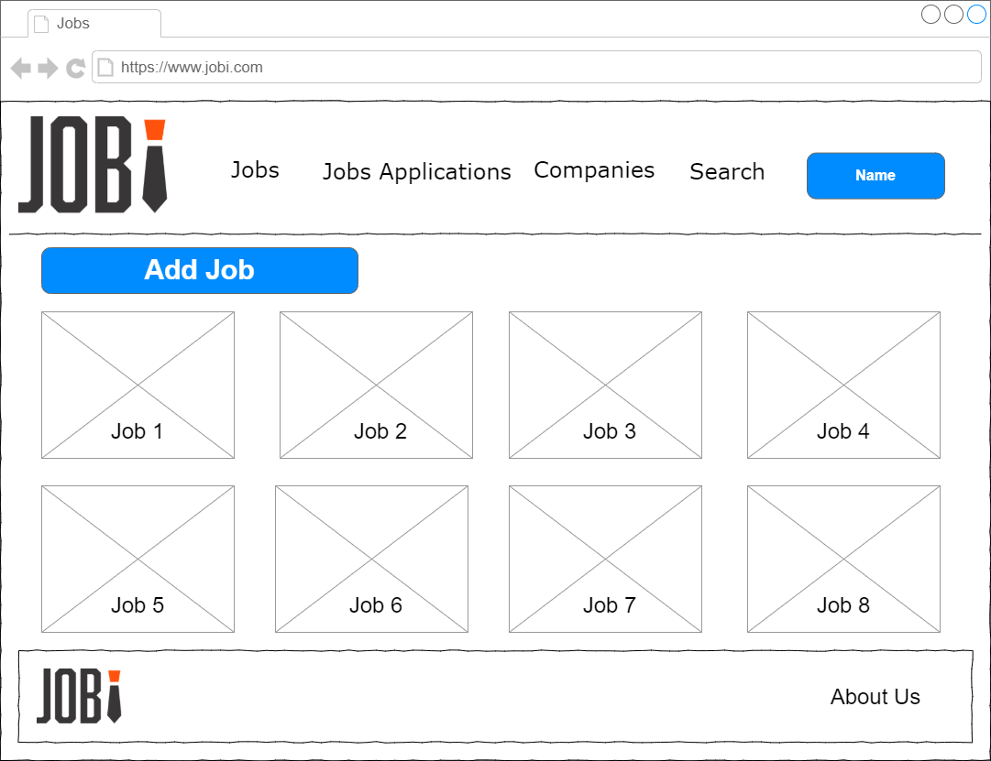

Slide 16
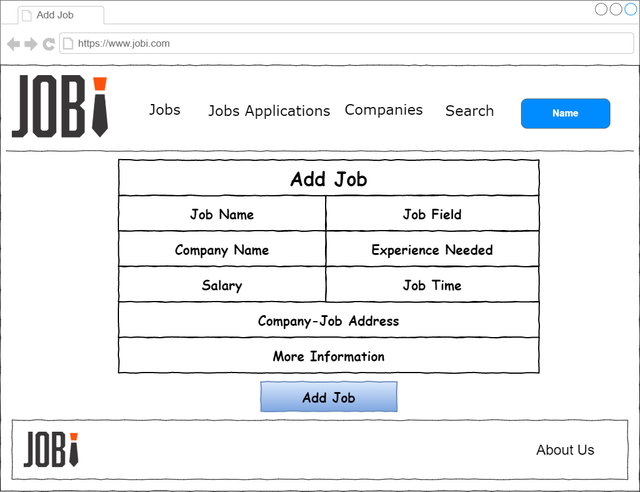

Slide 17
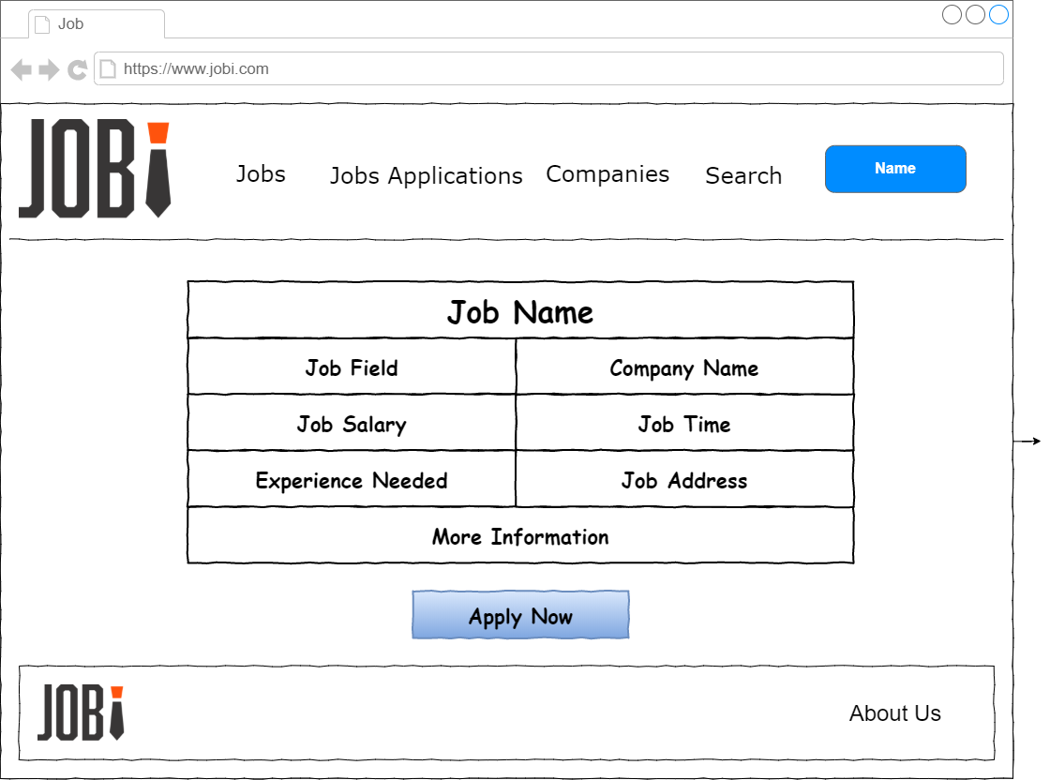

Slide 18
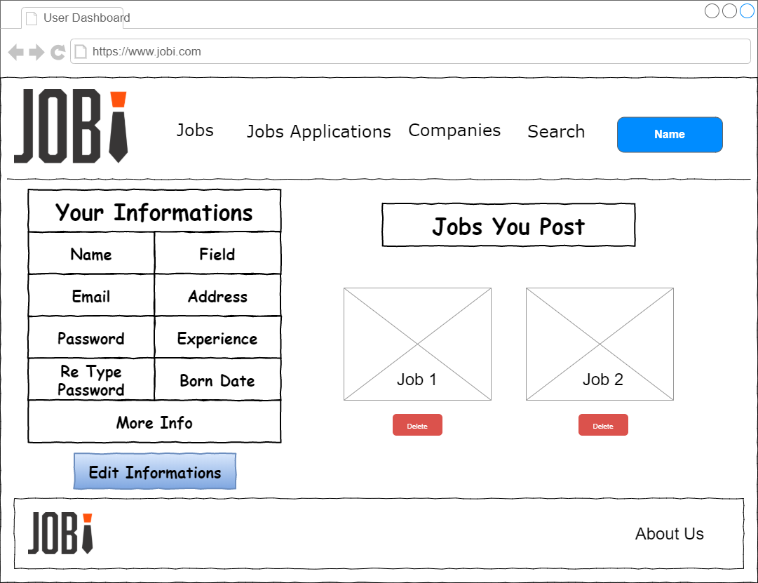

Slide 19
Website

Slide 20
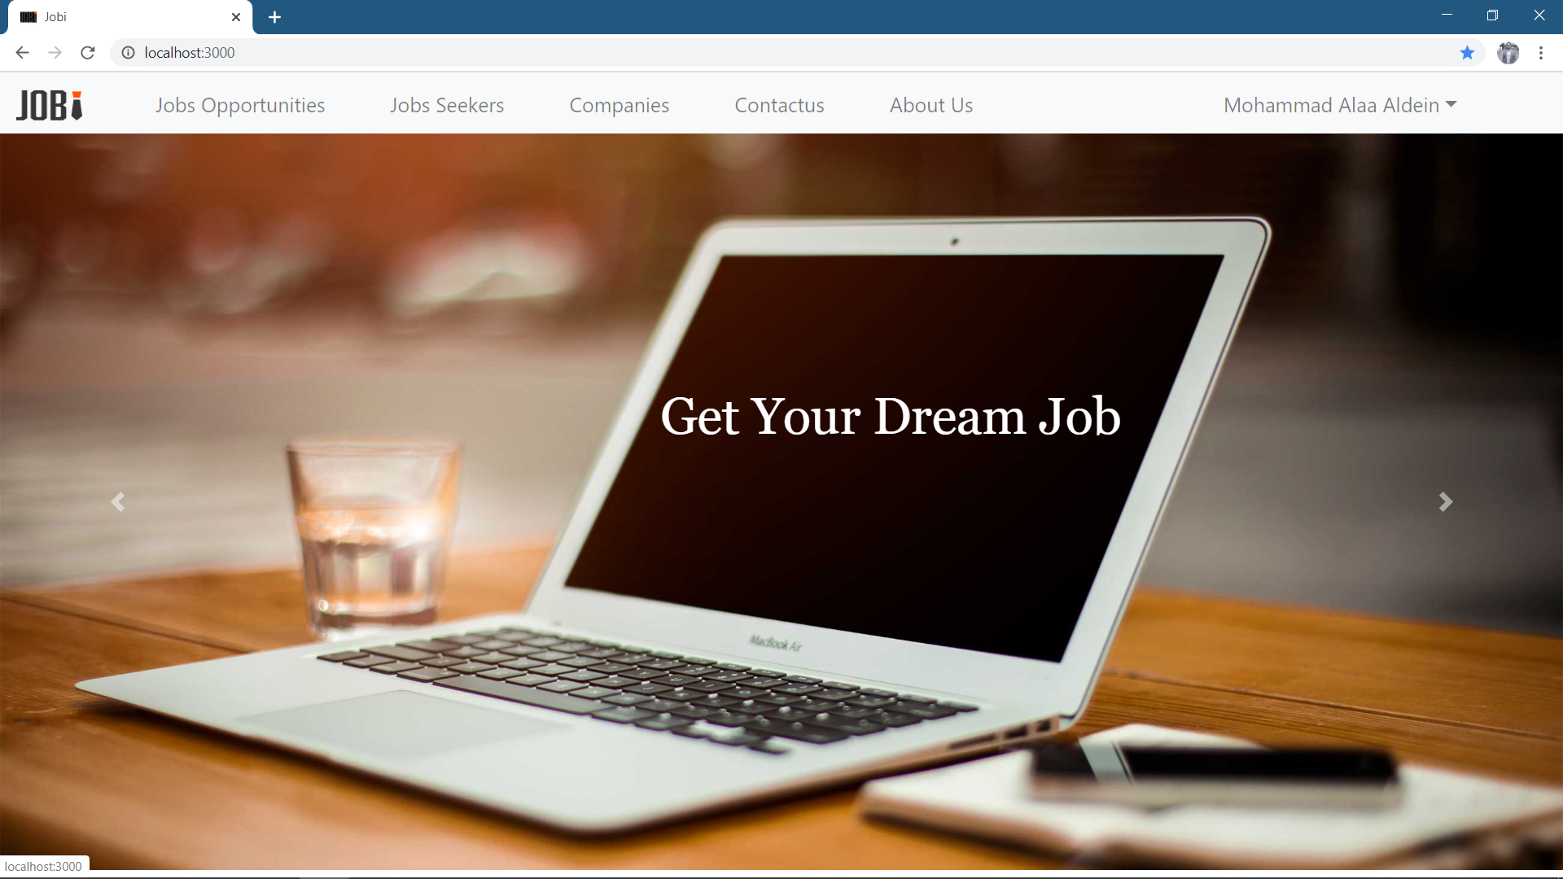

Slide 21
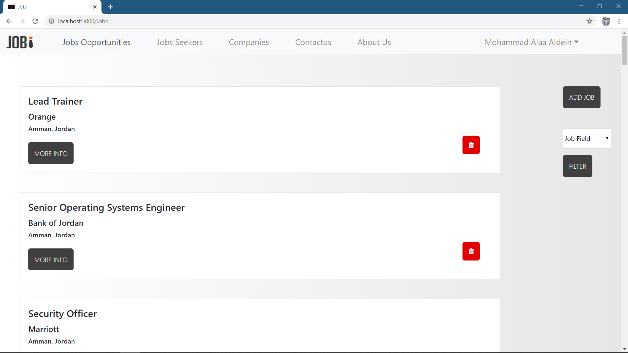

Slide 22
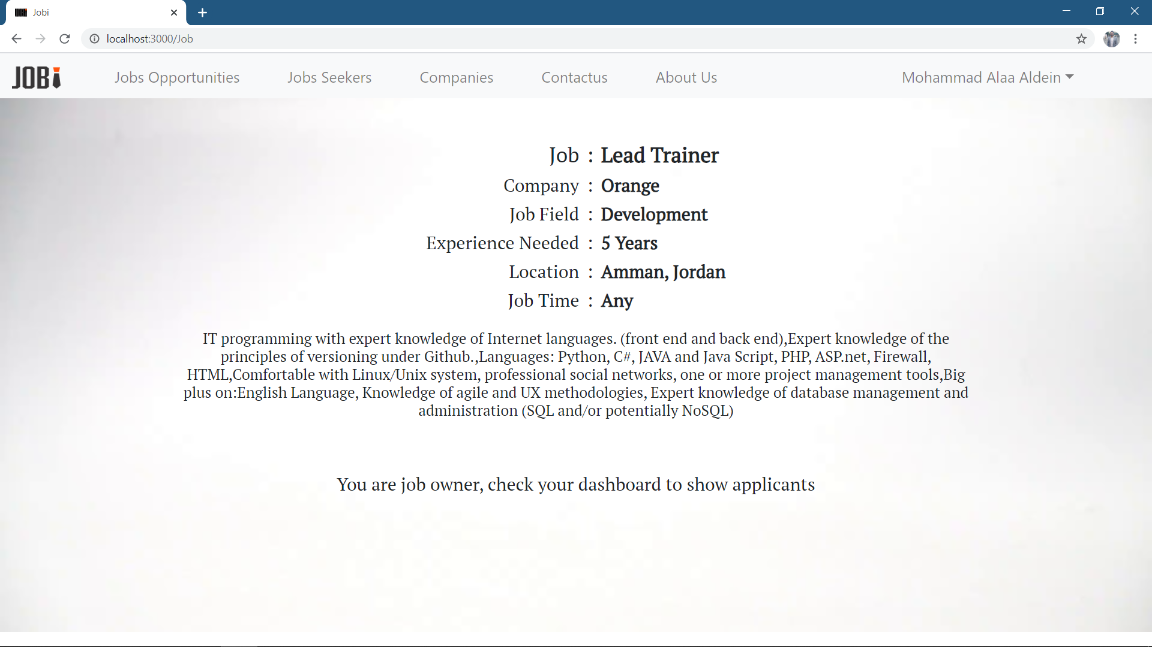

Slide 23
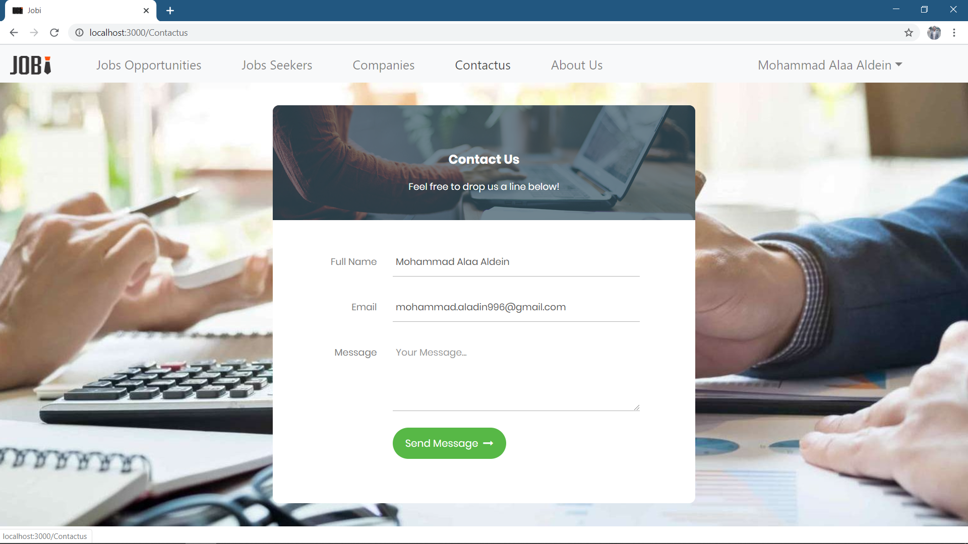

Slide 24
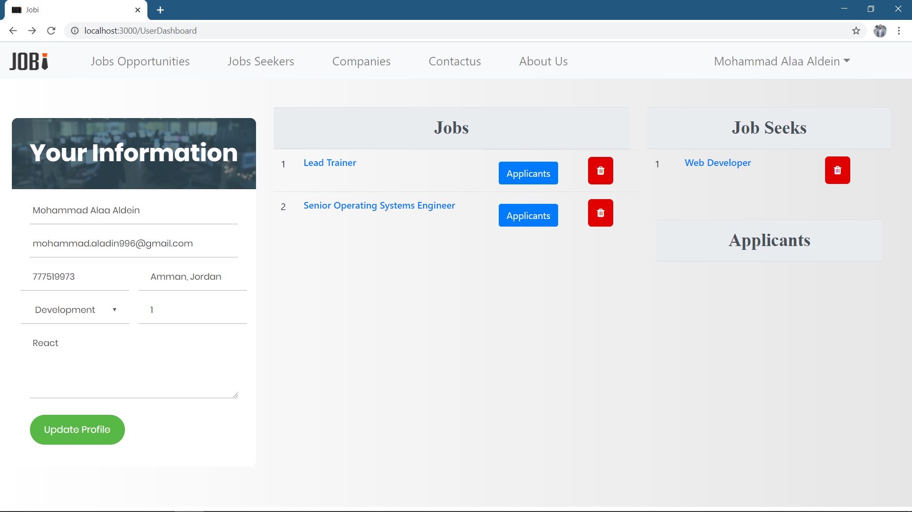

Slide 25
Now..
Lets take a tour

